Slide 1
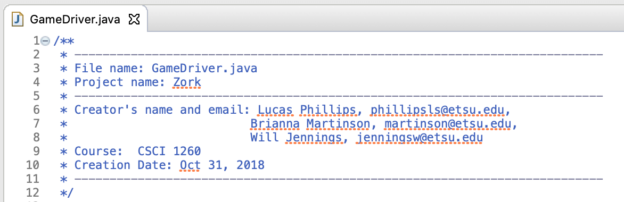
Java through Zork
Code Camp
Author: Brianna Martinson

Slide 2
Day 1 Set Up

Slide 3
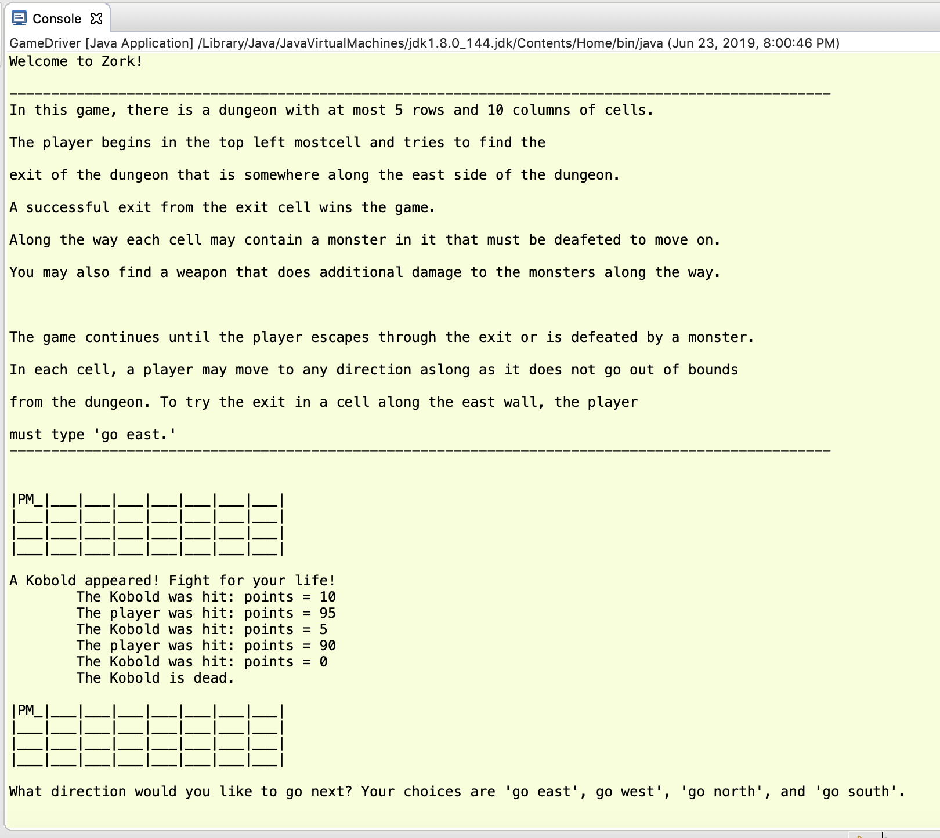
Define the Game
Text-based Role Playing Game

Slide 4
Game Design
What is the player?
What is their role?
What is their goal?
What things are they interacting with?
How are traversing the world?
What is the role?
Notes:
These things are all Objects in code

Slide 5
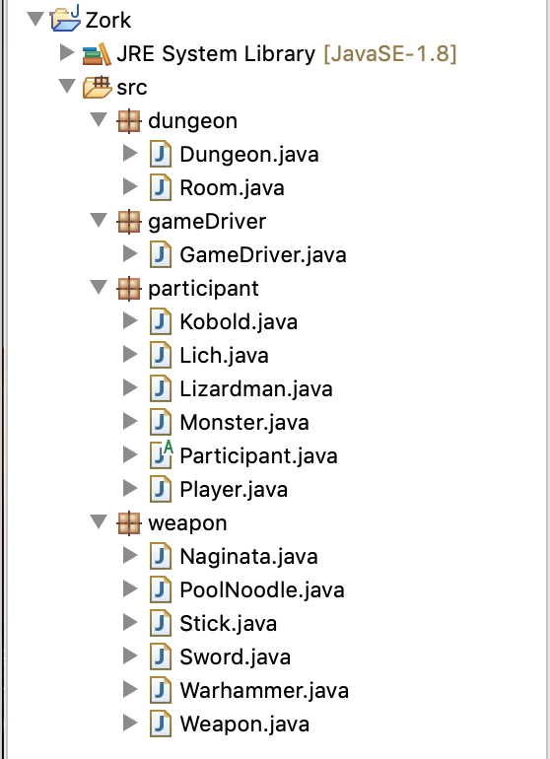
These are all Objects in code
You interact with these Objects in the Driver code

Slide 6
Variables
Code uses variables to do calculations. Variables are containers for storing data values.
String - stores text, like "Hello World"
int - stores integers (whole numbers), like 123 or -123
float - stores a decimal, like 19.99 or -19.99
char - stores single characters, like 'a' or 'B'
boolean - stores a state: true or false
Objects have special variables called attributes that are unique to that object, like a person’s age or height. Varies from person to person but the same concept for every person.

Slide 7
Set up your code
Your Driver
package gameDriver;
imports (Scanner: Input from player);
public class GameDriver
{
Your objects
private static Scanner kb = new Scanner(System.in);
public static void main ( String [ ] args)
{
Your code
}
}

Slide 8
Functions: making intro/outro dialog
Could type something like this in your main jumbled with your other code:
System.out.println(“Welcom to Zork!”);
System.out.println(“n\Outro Text Here”);
Or keep the main tidy by just calling self explanatory functions:
printIntro();
printOutro();
This is good coding practice to keep your code readable.

Slide 9
Functions
PRINT INTRO
public static void printIntro()
{
What you want to happen every time you call printIntro(); through out your code.
}
PRINT OUTRO
public static void printOutro()
{
What you want to happen every time you call printOutro(); through out your code.
}

Slide 10
Functions: What other functions might we need?
Functions are also great for when you want to repeat longer complicated chunks of code.
Saves you time (be lazy when you can)
Main tag is neater
Code is more readable
In Zork, what kind of actions might the player do that a function would help?

Slide 11
How does the player navigate?
How do they go room to room?
How does the player choose their direction?
What are their options?
Handle wrong input.

Slide 12
askDirection()
User Input:
direction = kb.nextLine().toLowerCase();
if(direction.equals ( appropriate response ))
{
if( the user can move)
code when the user moves;
else
System.out.println(“You can’t do that right now”);
else
code when input is invalid;
}
Notes:
Remember to check for the exit when you move.

Slide 13
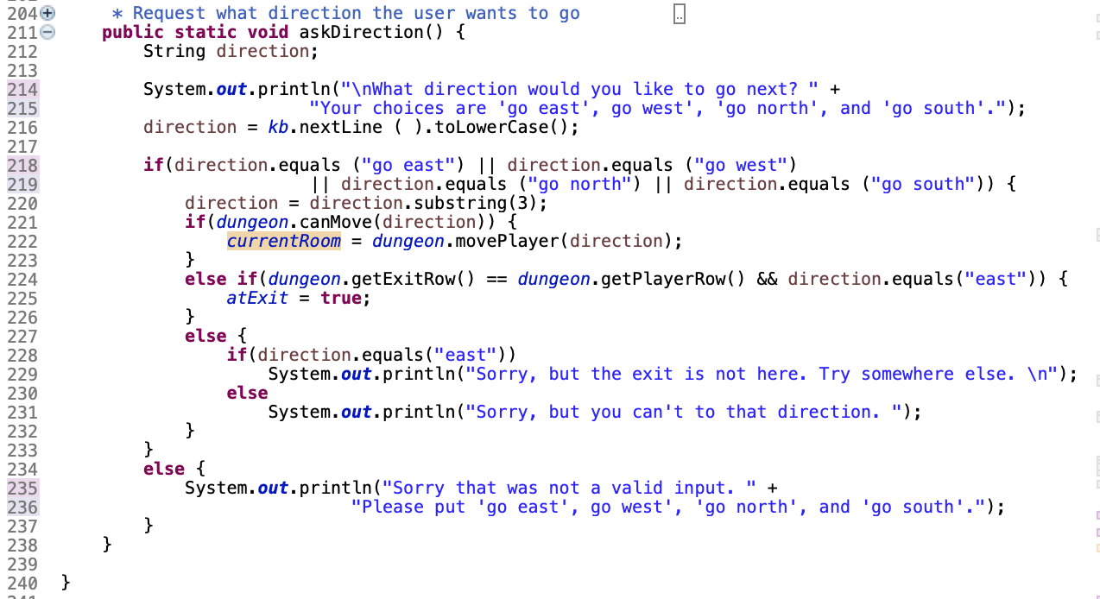

Slide 14
Battle Function
What variables would we need for it?
How are we defining battle?
What actions/situations repeat?
What defines the winner/when is it over?
How are we telling the player what is going on?
The player could lose.
Attacks can miss.

Slide 15
battle()
Get the fighters:
player = currentRoom.getPlayer();
monster = currentRoom.getMonster();
while(player.isAlive() && monster.isAlive())
{
player attacks;
if(monster.isAlive())
{
monster attacks;
}
}

Slide 16
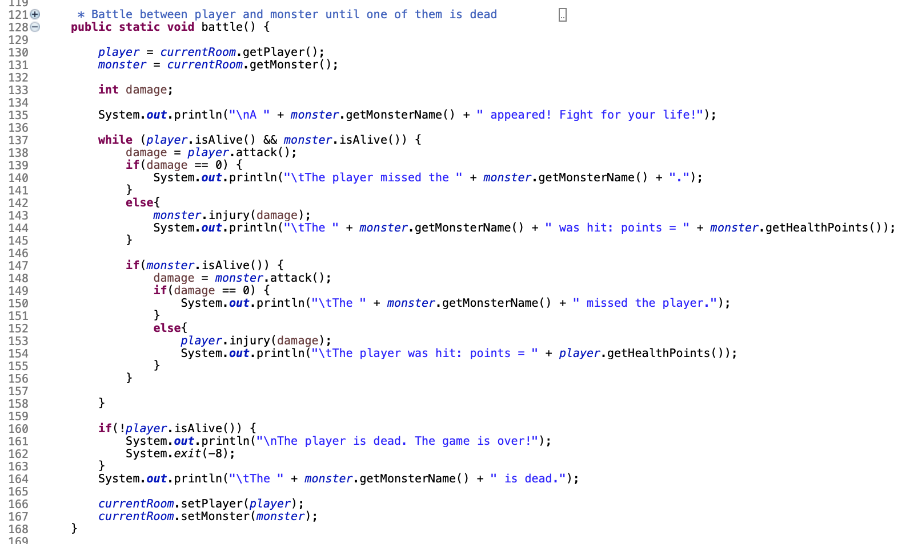

Slide 17
Finding a Weapon
How are we telling the player they found a weapon in the room?
What is going to happen when they find a weapon?
What can the player do with the weapon?
Do they have a choice?

Slide 18
findWeapon()
do{
System.out.println(currentRoom.getWeapon() + “You want to pick it up? (Yes or No)”);
code to tell them their input was bad;
}while(!(choice.equals(“yes”)||choice.equals(“no”)));
if ( yes )
code to pick up weapon;
else
System.out.println(“You didn’t pick it up”);
}

Slide 19
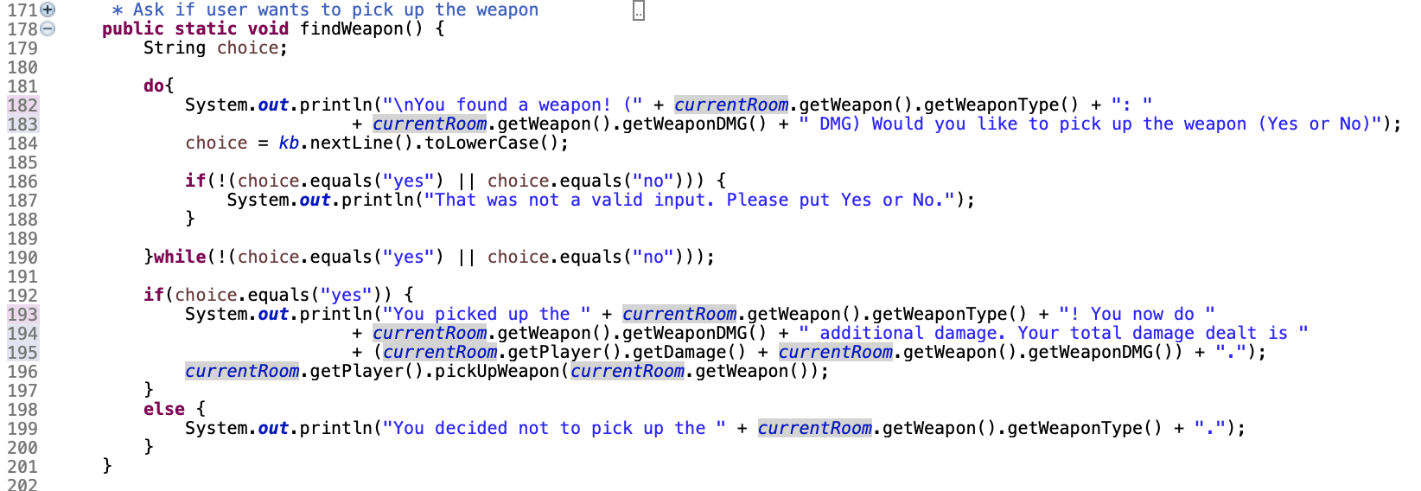

Slide 20
Set up the Scenarios
Logic Gates
When would the player trigger each function?
findWeapon: weapon in the room, player does not have a weapon
battle: monster in the room, monster is alive
askDirection: everything else in the room is done
printIntro and printOutro? Importance of brackets
When is the game?
While loop
while ( boolean )
{
Code running the game
}

Slide 21
Putting it all Together
Call your functions when appropriate
Set up the scenarios
When will the game end?
How long is the game/how does the player advance?

Slide 22
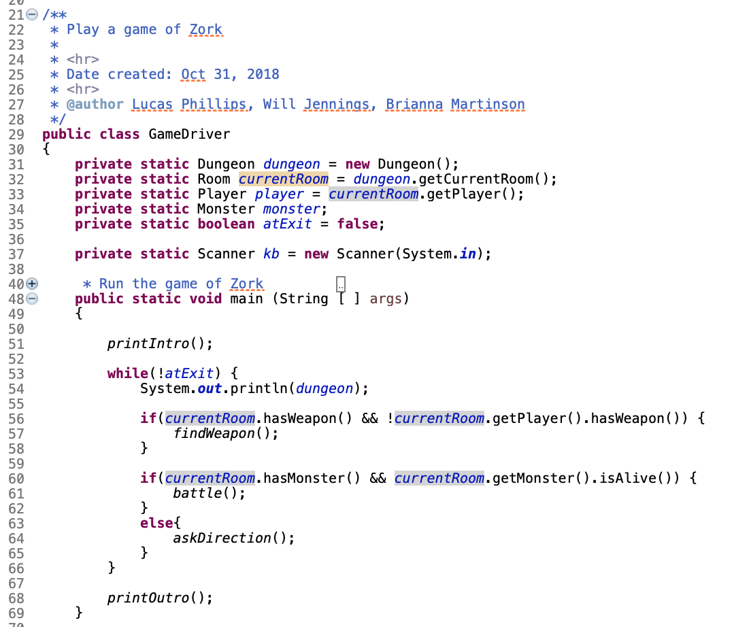
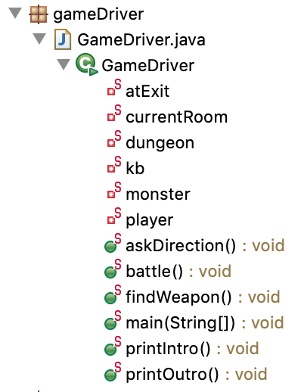

Slide 23
Day 2 Start Making Objects
Dungeon Package

Slide 24
dungeon Package
Dungeon.java
Room.java

Slide 25
Dungeon.java

Slide 26
dungeon Object
What exactly is a dungeon?
A collection/grid of rooms
What variables will we need to interact with within the class?
How can we tell how many rows there are?
How can we tell where the player is within the dungeon?
How can we tell where the exit is?
Is it going to be the same dungeon everytime?

Slide 27
dungeon Constructor
Every object needs a constructor. A constructor defines what that object is when one is first created.
We want the dungeon to be different so it needs Random.
public Dungeon()
{
ran = new Random();
fillDungeon();
}

Slide 28
dungeon Functions
getters for those Key Variables
public int getPlayerRow()
{
return playerRow;
}
Functions that populate the dungeon
fillDungeon(), addMonsters(), and addWeapon()
Functions to let the player move in the dungeon
canMove(String direction) and movePlayer(String direction)
toString()

Slide 29
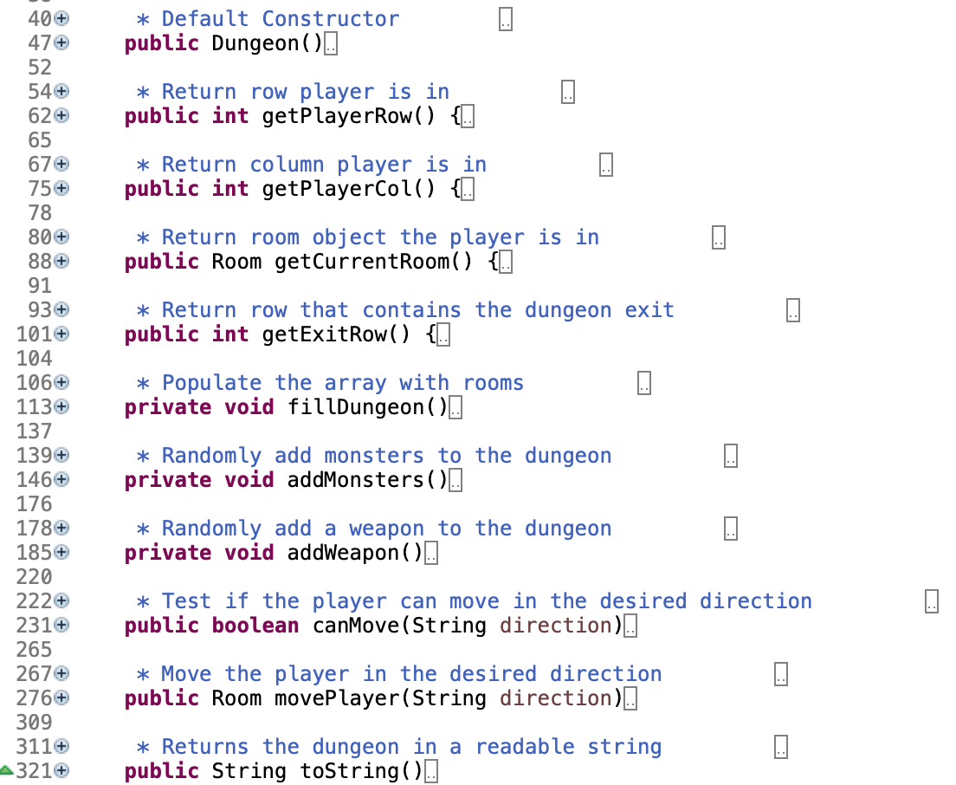
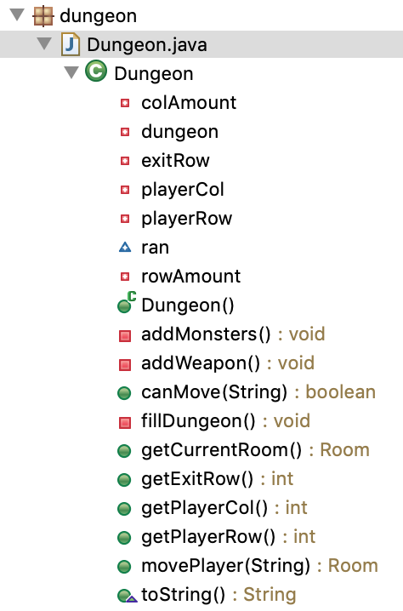

Slide 30
fillDungeon()
Needs to start the player at the start (0, 0)
Set how many total rooms are in this dungeon
Create all the rooms
Use a for loop with the number of rows and columns to do this
Create the exit
Add the monsters, the weapon, and the player to the dungeon

Slide 31
fillDungeon()
Creating the rooms: nested for loop
Inner loop happens j times for every i time
for(int i = 0; i < rowAmount; i++)
{
for(int j = 0; j < colAmount; j++)
{
dungeon[i][j] = new Room(null, null, null);
}
}

Slide 32
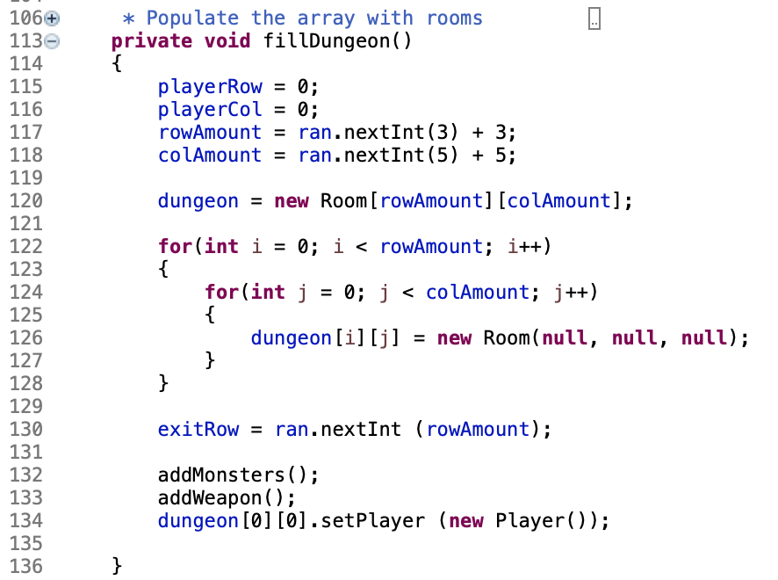

Slide 33
addMonsters()
Go through all of the rooms
Nest for loop
Not every room is going to have a monster though?
Let it be random to be more of a challenge
monsterSpawns = ran.nextBoolen();
There are several types of monsters
monsterType = ran.NextInt (100);

Slide 34
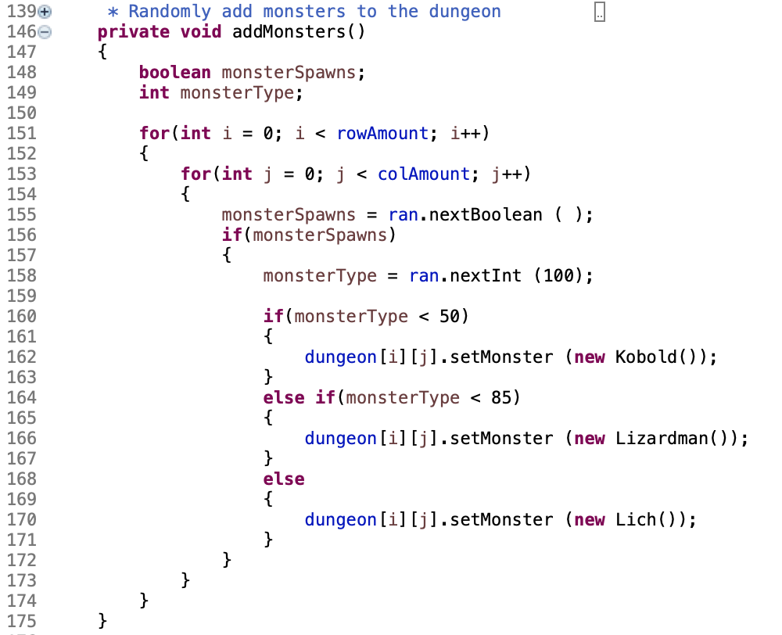

Slide 35
addWeapon()
Similar to addMonsters()
Instead of being a 50/50 chance, weapons are only a 10% chance of spawning
Go through all the rooms
There are several types of weapons

Slide 36
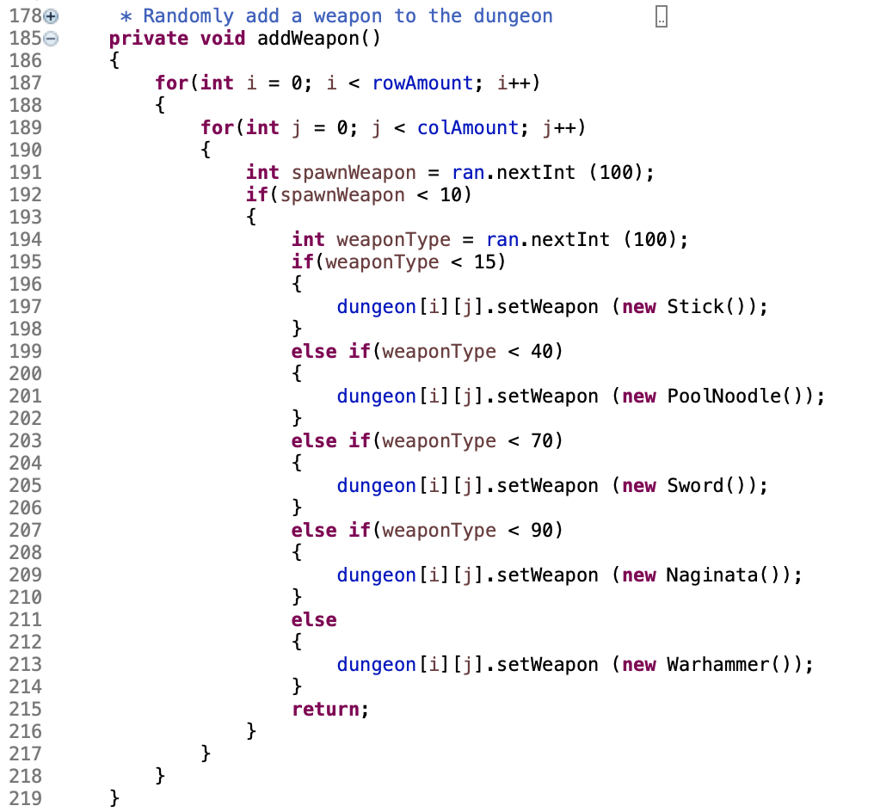

Slide 37
canMove()
switch case
Do certain things depending on the player’s input
switch(direction)
{
case “east”
if ( they won’t go out of the grid)
canMove = true;
break;
...
}
return canMove;

Slide 38
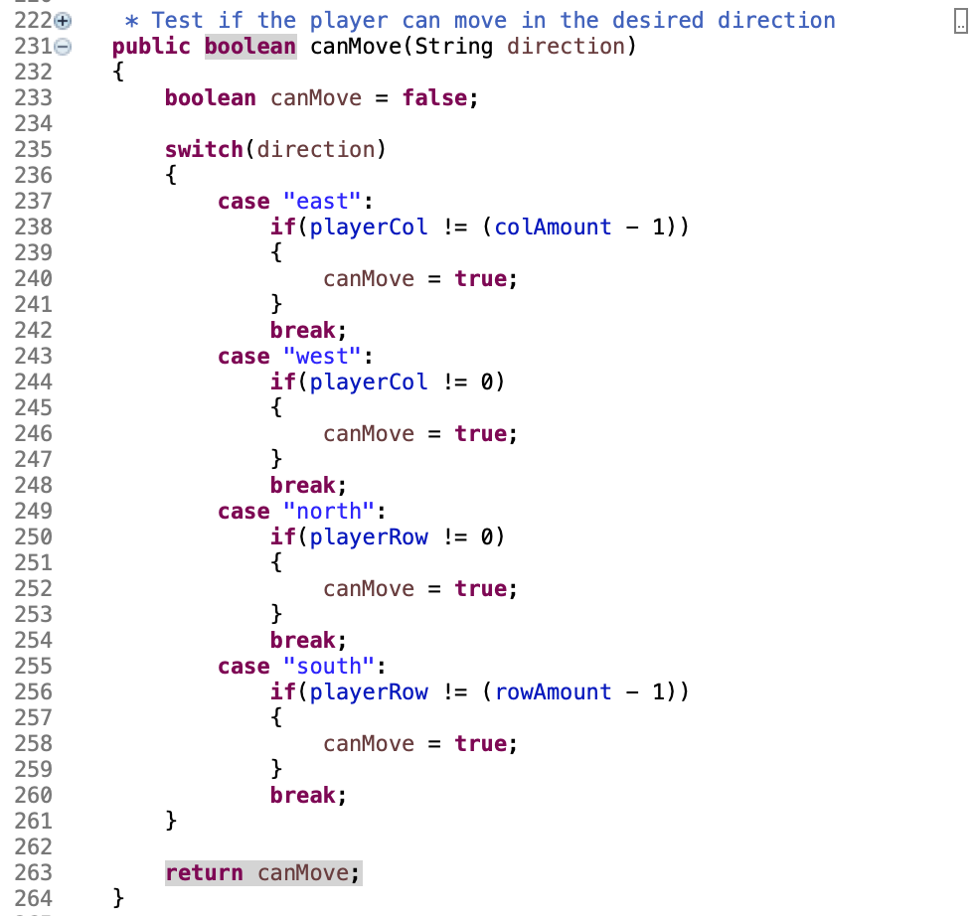

Slide 39
movePlayer()
Similar to canMove() with doing certain things for each input the player might use.
This functions actually moves the player’s coordinates and puts them in a different room.
dungeon[playerRow][playerCol + 1].setPlayer (dungeon[playerRow][playerCol].getPlayer ( ));
dungeon[playerRow][playerCol].setPlayer(null);
playerCol++;
returnRoom = dungeon[playerRow][playerCol];

Slide 40
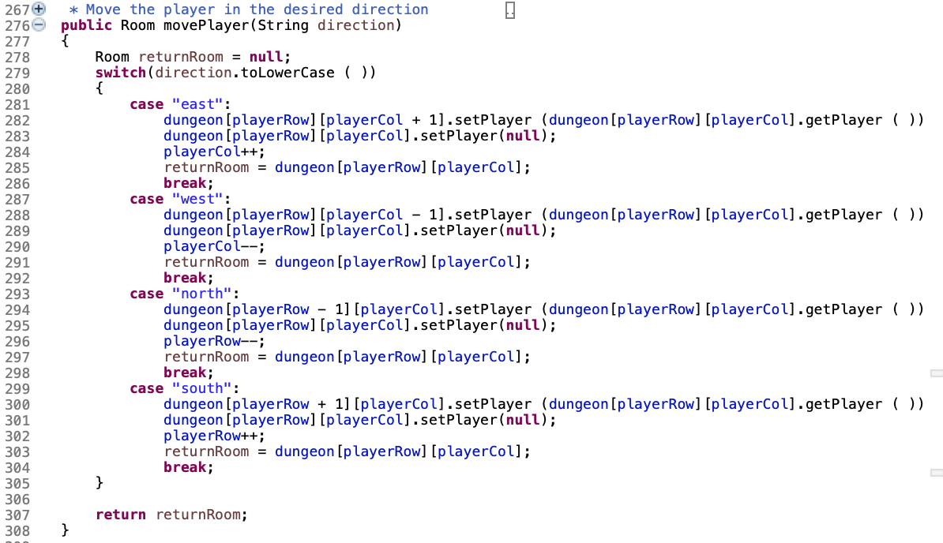

Slide 41
toString()
It is good standard to always have a toString() method.
It converts the information of the object into a string that can be printed to the screen.
For dungeon, the user would probably like to know
Layout of the map
Where they are in it
What else is in the room with them.

Slide 42
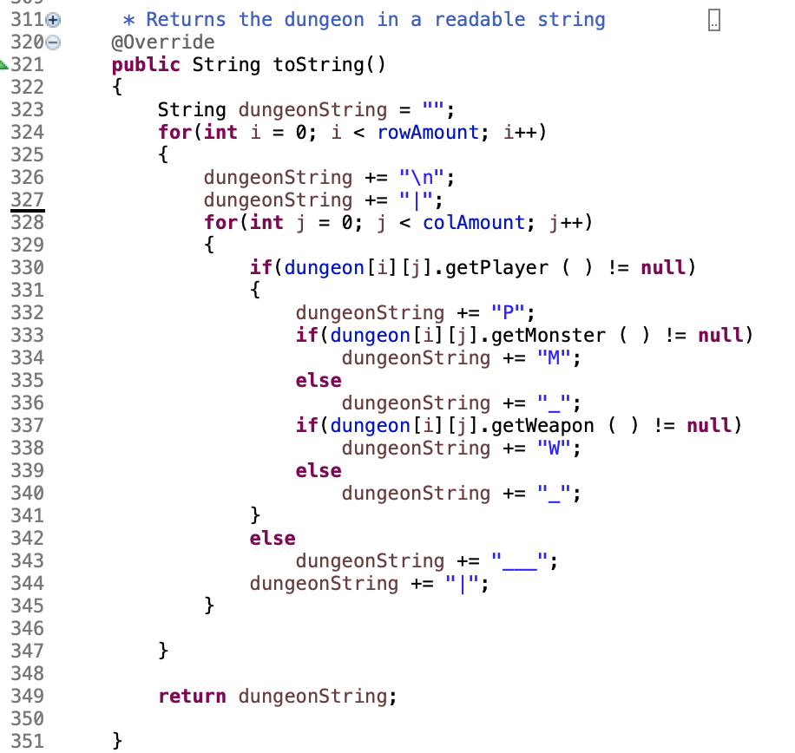

Slide 43
Room.java

Slide 44
room Object
What exactly is a room?
What variables will we need to interact with within the class?
What thing are in each room?
What functions will be needed?

Slide 45
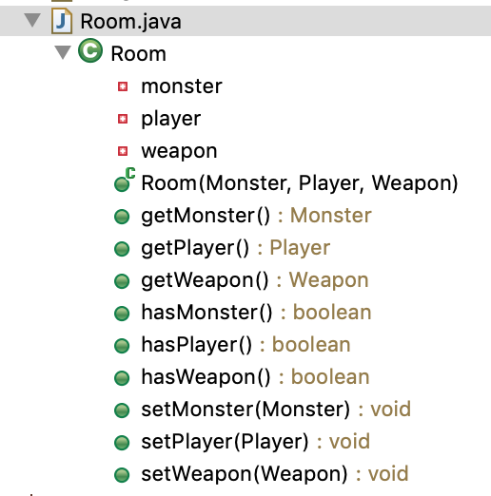

Slide 46
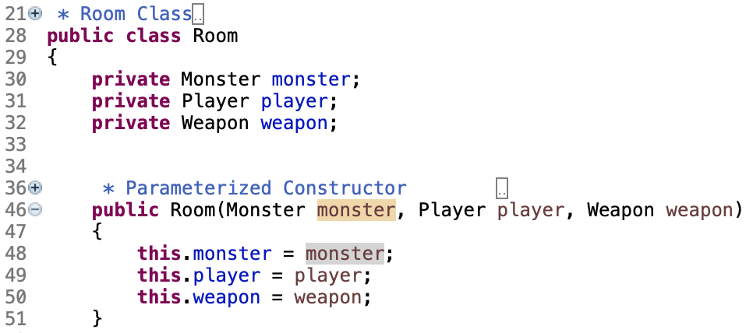
room Constructor
Parameterized Constructor
Each room is a little different based on what is in the room when it is created.
It sets the properties for that specific room with the parameters being pushed into the constructor.
Notes:
For example new Room(null, null, weapon) has no monsters, no players, but it does have a weapon in that specific room.

Slide 47
room Functions
Getters and Setters for those key variables
getMonster() setMonster(Monster monster)
getPlayer() setPlayer(Player player)
getWeapon() setWeapon(Weapon weapon)
Functions that check to see if that thing is present in the room
hasPlayer()
hasMonster()
hasWeapon()

Slide 48
Day 3 Making Objects
Weapon Package

Slide 49
weapon Package
Different types of weapons:
Stronger and weaker weapons
Naginata,.java PoolNoodle.java, Stick.java, Sword.java, Warhammer.java
Inheritance: what do the weapons have in common skeleton/necessities of the classes that inherit it

Slide 50
Weapon.java
The parent class

Slide 51
weapon Object
What exactly is a weapon?
What is a weapon’s attributes?
It’s damage and the type of weapon it is.
What functions will be needed?

Slide 52
Protected variables
Since we are using weapon purely as a superclass for the other weapons, we use protected variables for the object’s attributes.
“Variables, methods, and constructors, which are declared protected in a superclass can be accessed only by the subclasses in other package or any class within the package of the protected members' class. The protected access modifier cannot be applied to class and interfaces,” (Google).
Notes:
https://www.google.com/search?q=when+to+use+protected+in+java&rlz=1C5CHFA_enUS758US758&oq=when+to+use+protect&aqs=chrome.2.69i57j0l5.5887j1j7&sourceid=chrome&ie=UTF-8

Slide 53
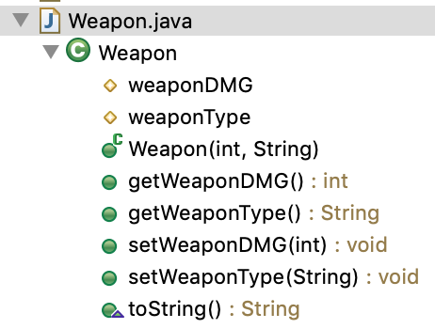
weapon Object
Treat everything the same.
Needs a constructor, getters and setters, and a toString().

Slide 54
Warhammer.java
The child class

Slide 55
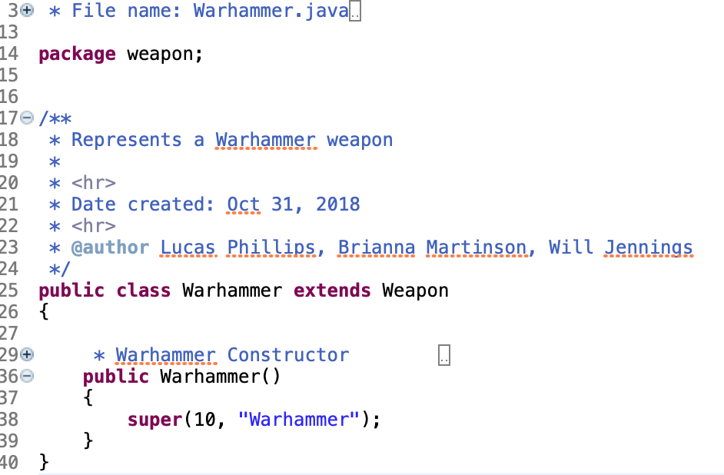
warhammer Object
Warhammer inherits from Weapon. So all that is left to code is what is specific about THIS particular weapon.
The super keyword refers to the class’s superclass/parent.

Slide 56
The other weapons
The other weapons would follow the same kind of thing that the Warhammer class does.
Vary from weapon to weapon but follows the same model that the Weapon class set.
Have at least three different weapons.
Remember the super keyword when referring to the parent’s code.

Slide 57
Day 4 Making Objects
Participant Package

Slide 58
participant Package
Different types of participants:
Participant: Monsters (Monster.java) and the Player (Player.java)
Monsters: Kobold.java, Lich.java, Lizardman.java
Inheritance again with the monsters and Monster.java, and Monster.java and Player.java with Participant
Abstract class: a superclass that sets up the skeleton/necessities of the classes that inherit it but nothing is fully defined in it.
Participant

Slide 59
Participant.java
Abstract class

Slide 60
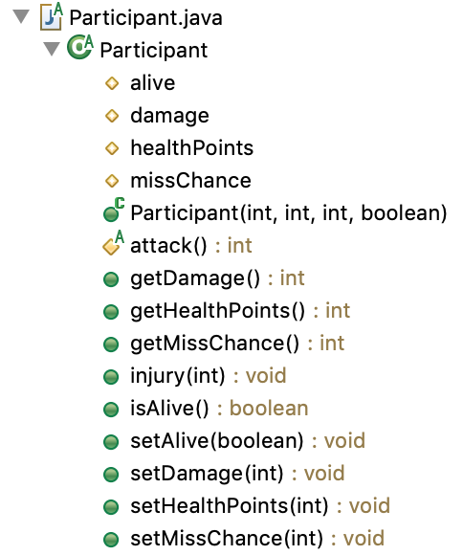
participant Class
Similar to the weapon class because it acts as a skeleton to the other classes in the package.
Since this is an abstract class it also uses protected attributes
public abstract class Participant
{
protected int healthPoints;
protected int damage;
protected int missChance;
protected boolean alive;
}

Slide 61
participant Class
Similar to protected variables, there are also protected functions.
Protected functions are only declared then the classes that inherit participant define that function as it applies to it.
The attack function is an example of a protected function:
protected abstract int attack();

Slide 62
Monster.java

Slide 63
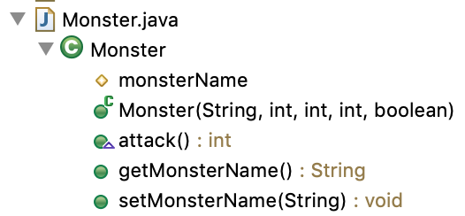
monster Object
The monster class should set up the code for the different types of monsters.
The monster class uses the participant class as a skeleton so remember the keyword extends and super

Slide 64
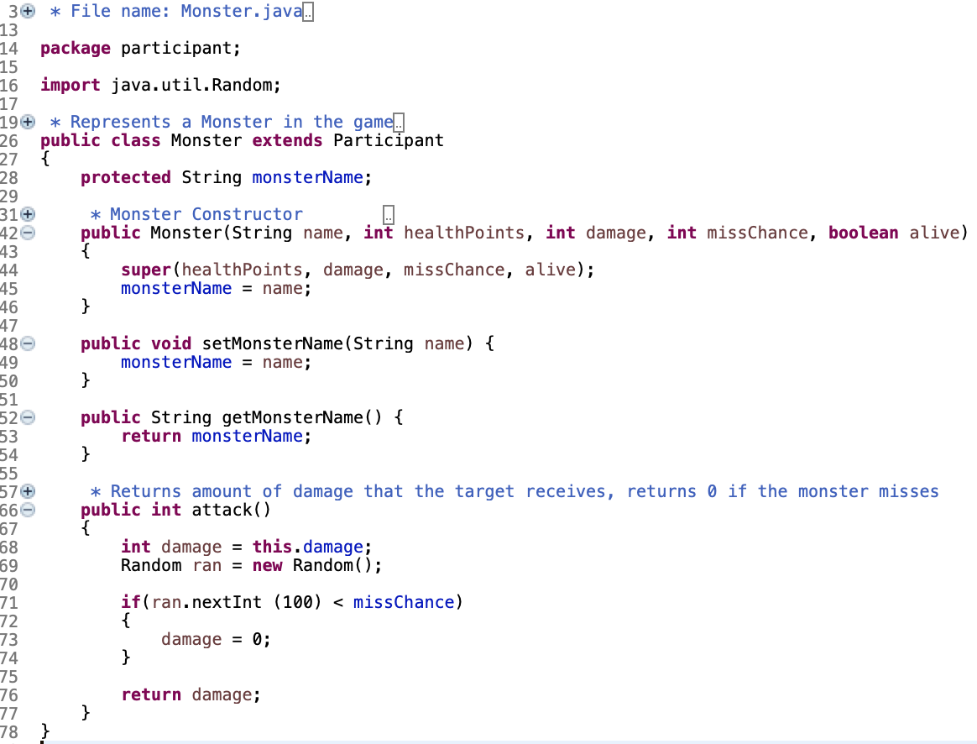

Slide 65
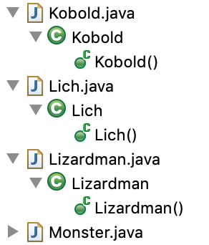
The other monsters
Vary from monster to monster but follows the same model that the Monster class set.
Have at least three different weapons.
Similar concept of weapon to warhammer

Slide 66
Player.java

Slide 67
player Object
Extends from Participant
What attributes would the player have?
How would attack be defined for player?

Slide 68
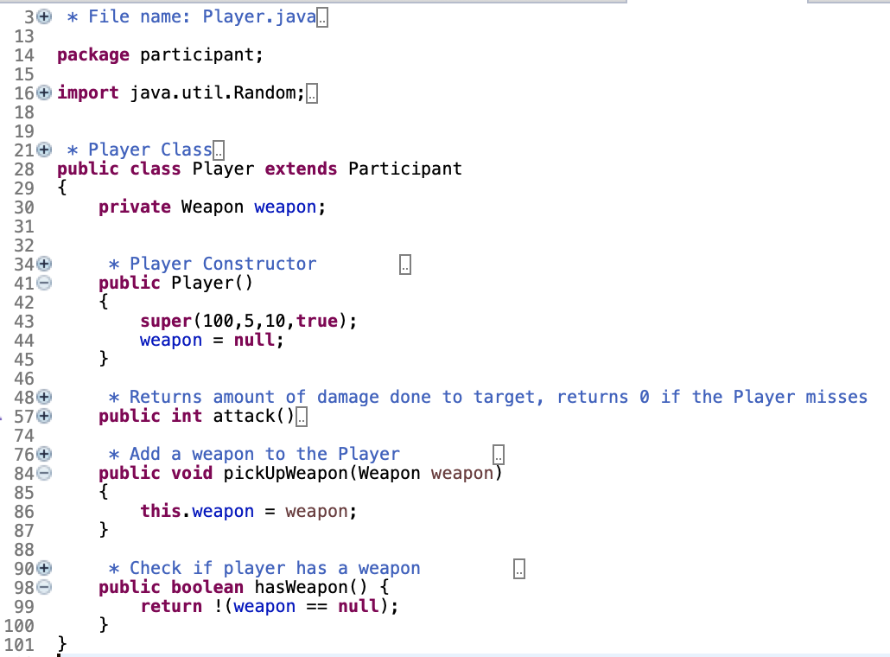
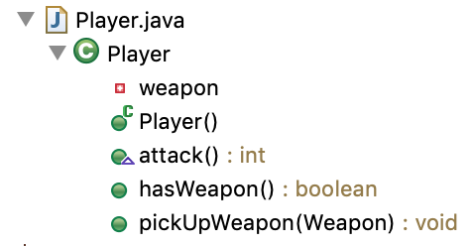

Slide 69
Troubleshooting

Slide 70
Troubleshooting
Now that all the objects are fully coded:
Go back to your driver
Review the logic and make sure it will work with how the objects were coded
If it doesn’t re-code parts of the driver
Run the code
Fix the errors
Run it again and play the game!

